Slide 1

Basics of HTML & CSS
Web campaign Session 1
Brij Desai brij-desaii
Nitheezkant R nitheezkant

Slide 2
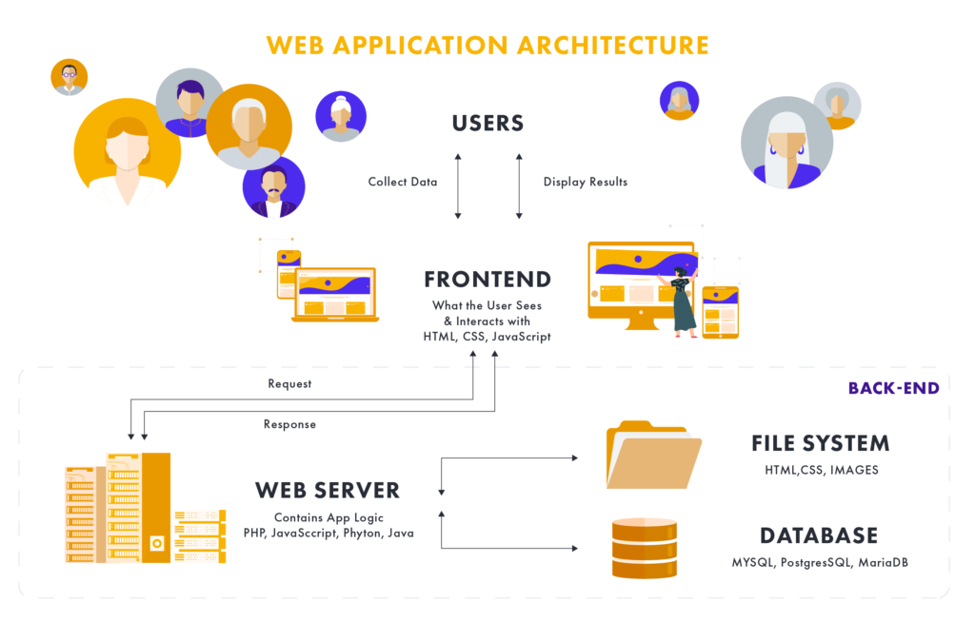
Anytime I’m involved with anything that’s well-received, it’s a surprise to me.
Larry David

Slide 3
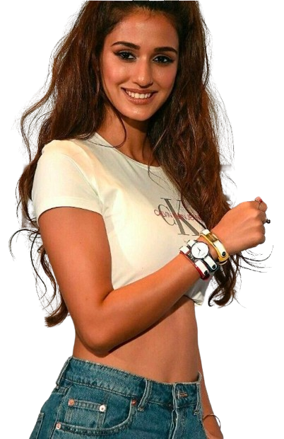
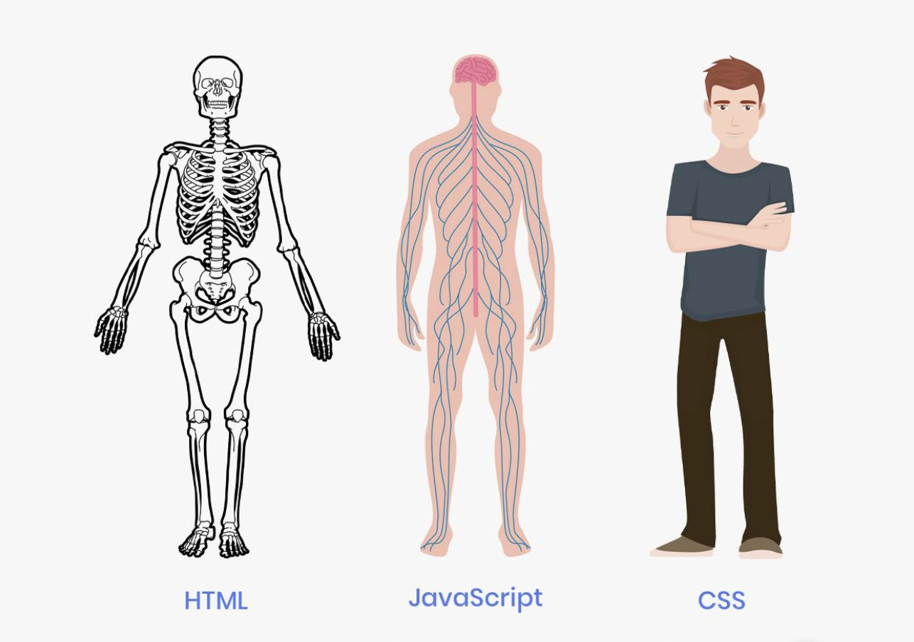
Anytime I’m involved with anything that’s well-received, it’s a surprise to me.
Larry David

Slide 4
All kinds of styling should be always done in CSS.
HTML is solely for structure.

Slide 5
HyperText Markup Language
(along with search engine optimisation)

Slide 6
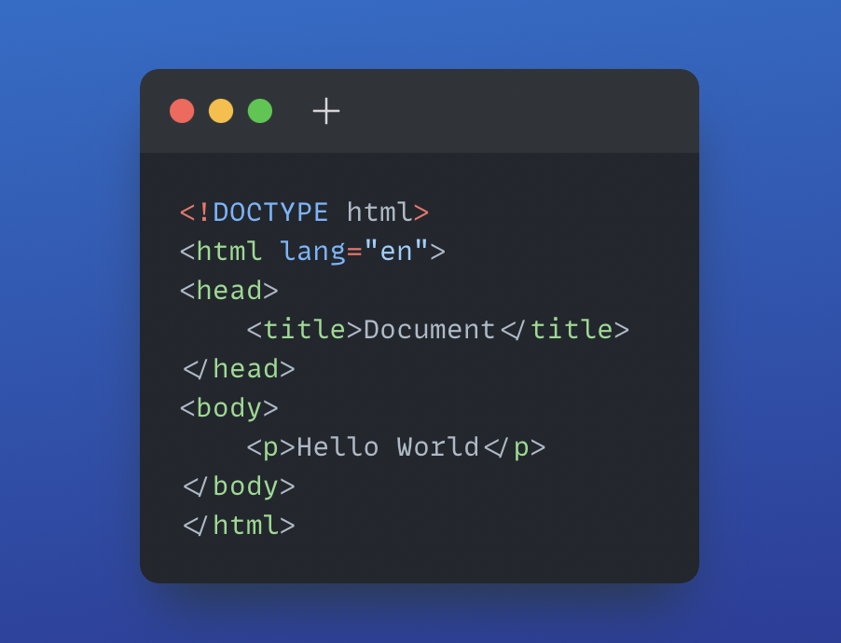
Boilerplate Code
Headline

Slide 7
All about Head
<title>
<link rel="stylesheet" href="style.css">
<meta charset="UTF-8">
<meta name="description" content="This is a detailed tutorial on HTML">
<meta name="viewport" content="width=device-width, initial-scale=1">
<meta http-equiv="refresh" content="30">

Slide 8
All about Text
Paragraphs
1)em 2)i 3)strong 4)b
Headings
<h1></h1> <h2></h2>...<h6></h6>
Entities
&lt; &gt; &copy; &nbsp; loremN

Slide 9
All about HyperLinks
Anchor tag
<a href=””> </a>
download
HyperLink within same page
target=”_blank” attribute
https:// and mailto:

Slide 10
Images
Lists
Buttons
<img src=”” alt=””>
<ul><li></li></ul>
<ol><li></li></ol>
<button type="button">Click Me!</button>

Slide 11
Div & Span
<body>
<h1>The Adventures of My Cat Lucky</h1>
<div id="mainContent">
<p>My cat Lucky has a lot of adventures. Yesterday she <a href="mouse.html">caught a mouse</a>, and this morning she caught two!</p>
<p>Here's a picture of Lucky:</p>
<img src="lucky.jpg" alt="Lucky">
</div>
<div id="sidebar">
<h2>Buy our stuff!</h2>
<p>Some of our products include <span class="product">SuperWidgets</span>, <span class="product">MegaWidgets</span>, and <span class="product">WonderWidgets</span>.</p>
</div>
</body>

Slide 12
Let’s Manipulate Grades

Slide 13
CSS
Making your website look good
Add styles to HTML with CSS.
Understand how to use the class and ID attributes.
Add styles to specific elements using the correct selectors.

Slide 14
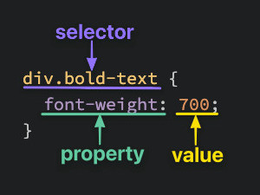

Slide 15
Selectors and Properties
Class and ID attributes
Codepen Tutorial

Slide 16
Adding CSS to HTML
External CSS
Internal CSS
Inline CSS

Slide 17
The Box Model
Everything is a box
Padding
Border
Margin

Slide 18
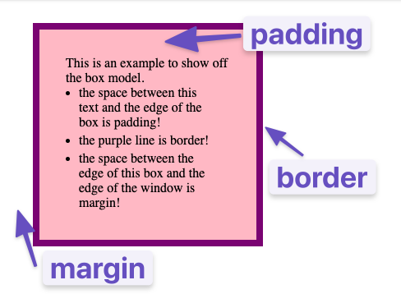
Codepen Tutorial

Slide 19
Thank You For Attending
Web campaign Session 1
Brij Desai brij-desaii
Nitheezkant R nitheezkant
*slides not generated by ChatGpt*

